Slide 1
Setting up ODK Software
on Windows Computers
Dr. Caroline Krafft
St. Catherine University
cgkrafft@stkate.edu
Version: January 14, 2018

Slide 2
More extensive directions from: http://opendatakit-dev.cs.washington.edu/2_0_tools/release/218/application_designer
2

Slide 3
Necessary Software
3
Java - Java is required by the Android Software Development Kit (SDK)
Chrome - Google's Chrome browser, used to preview surveys on laptop/desktop
Node.js- a framework for applications
Grunt - a task-based scripting environment written in Node.js
Android SDK - the software development kit for Android devices
ODK Application Designer v2.0.zip - a zip containing this ODK tool
ODK Suitcase – For downloading collected data

Slide 4
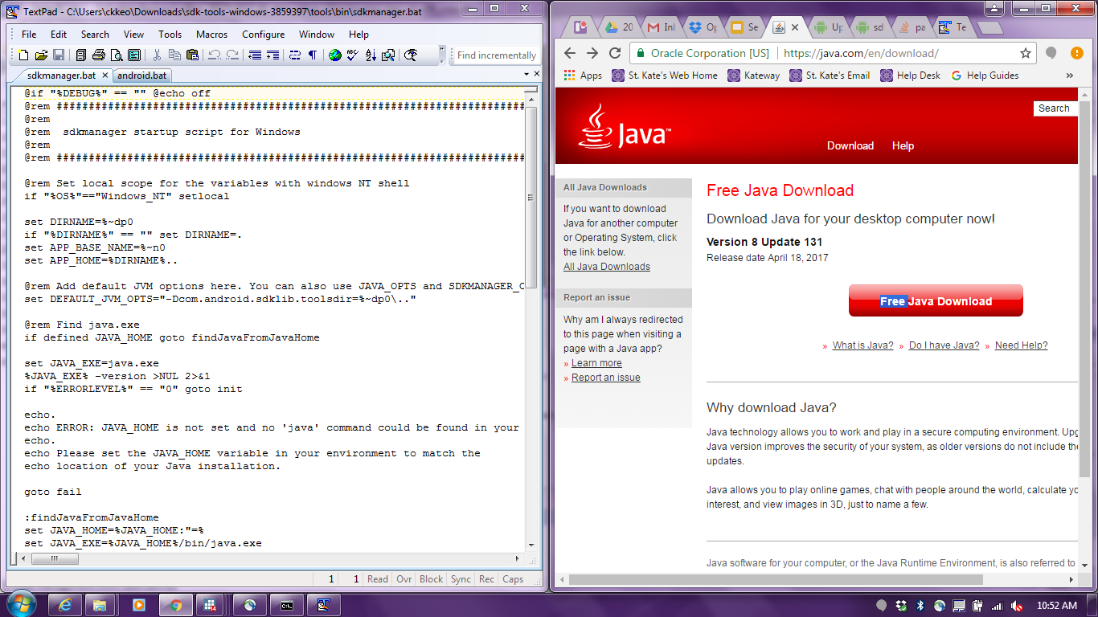
Java
4
Make sure Java 7 or higher is installed on the computer you plan to use. If it is not, download and install it.
Notes:
https://java.com/en/download/

Slide 5
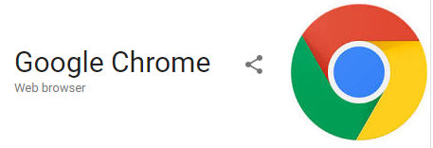
Chrome
5
Chrome - Google's Chrome browser, used to preview surveys on laptop/desktop
Install from here
Notes:
https://www.google.com/intl/en/chrome/browser/desktop/index.html

Slide 6
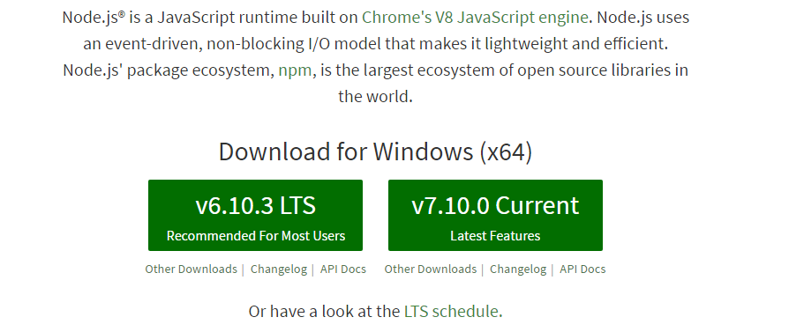
NodeJS
6
Must use Version 6.2.2 or higher. To avoid directory path problems on Windows, ODK requires npm (package manager for JavaScript) v3, and that is only available on this node release (or higher).
Follow the instructions here to install NodeJS.
Notes:
https://nodejs.org/en/

Slide 7
Grunt
7
After installing NodeJS, install Grunt On Windows by opening a cmd window (go to Start Menu, search for cmd and open it)
Within this terminal, type command:
npm install -g grunt-cli
3. If grunt is successfully installed, the following command:
grunt --version Should display the installed version of grunt. e.g., grunt-cli v1.2.0.
Note: throughout slides blue is where you type, red is what you type, green is what you (should) see

Slide 8
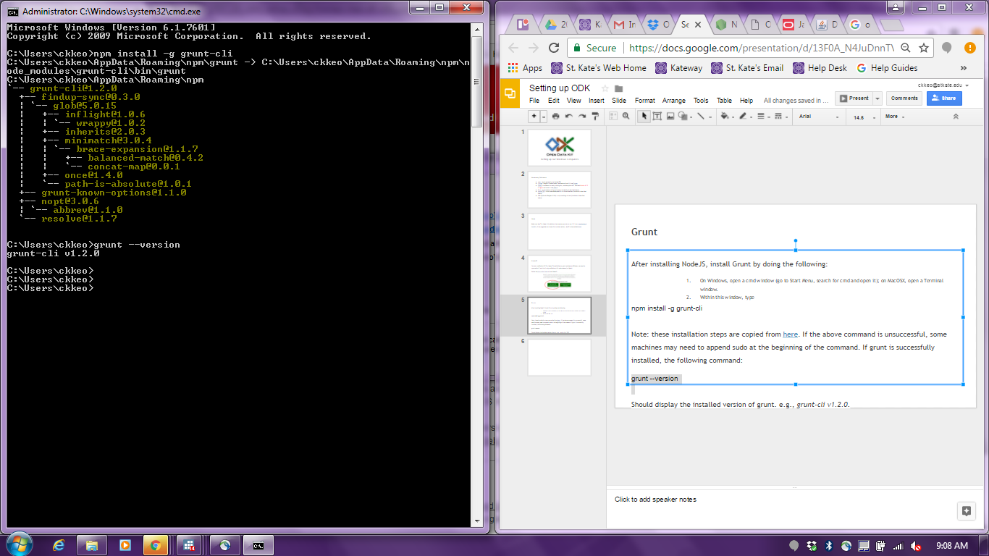
8
Install
Version

Slide 9
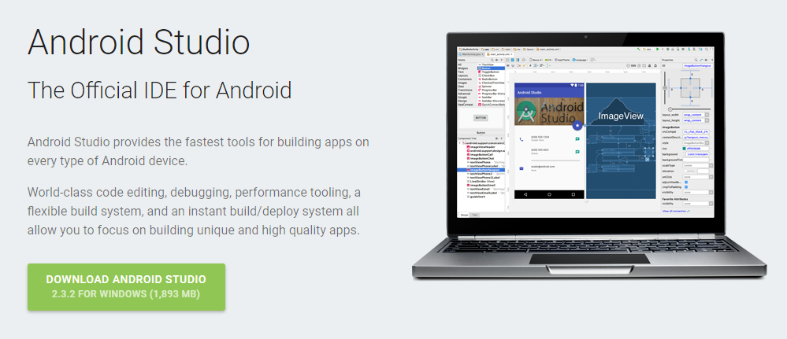
Android SDK
9
https://developer.android.com/studio/index.html#tos-header
Takes about 12 minutes

Slide 10
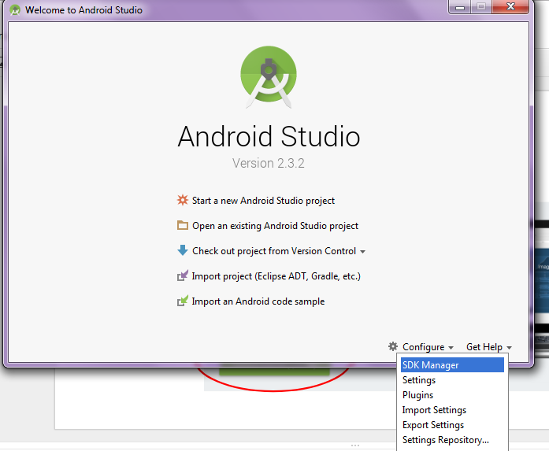
In Android Studio
10
→ Install
→ Configure
→ SDK Manager

Slide 11
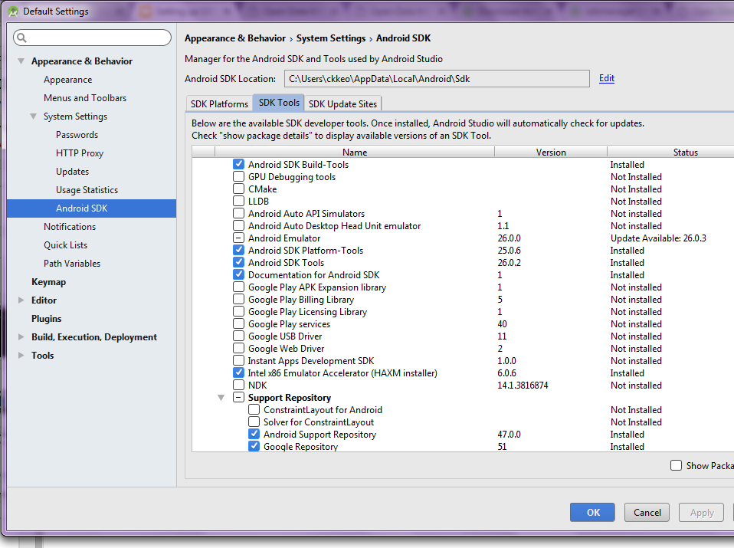
In SDK configuration
Check all the SDK items
Check Google USB Driver
Check GPU Debugging Tools
Apply
Notes:
C:\Users\[username]\AppData\Local\Android\sdk\platform-tools
Check adb is there

Slide 12
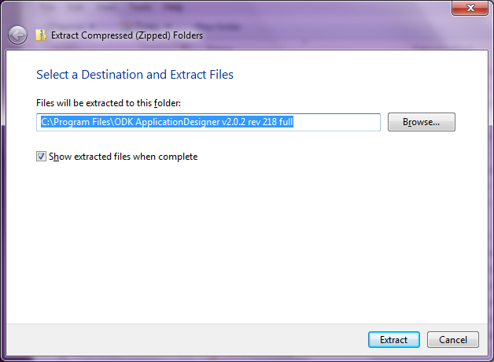
ODK Application Designer v2.0.zip
12
http://opendatakit-dev.cs.washington.edu/2_0_tools/download_version
Find the latest version of Application Designer.
Right click on the downloaded zipped file→ Extract All

Slide 13
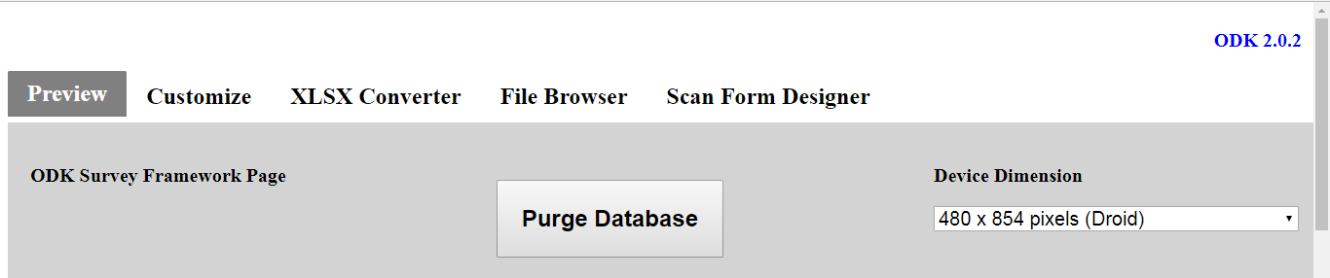
Launching the Application Designer
13
The ODK Application Designer is
A workspace containing the forms and files you have created and
A set of tools used for that development.
To launch the application designer, open the 'cmd' shortcut and use the command cd to change the directory to your app-designer. Example:
cd C:\Users\[username]\Documents\app-designer
Then type in the command line: grunt
This should automatically
open Chrome and display
the Preview tab.
Notes:
When you need to stop the server, return to the command or terminal window where you typed grunt and press ctrl+c (that is the control and the letter c key at the same time). This will stop the process.

Slide 14
Downloading ODK Suitcase
14
ODK Suitcase downloads data from the server
Download latest version here
Double click to start/Open to make sure it downloaded correctly.
You’ll use this much later when you actually have data!
Notes:
http://opendatakit-dev.cs.washington.edu/2_0_tools/download_version

